Slide 1

Predicting Machinery Downtime
Ahsan Ahmad Charlie Vandel Scott Silverstein Rylan Tribush

Slide 2


Business Problem
Downtime Costs
Machines fail unexpectedly. Output drops. Deadlines missed.
Notes:
What happens when production stops unexpectedly?
At Swire Coca-Cola, unplanned machinery breakdowns halt production, delaying your ability to meet demand. It disrupts operations and lowers output.
This slide represents the impact of mechanical failures across our facilities. It’s a constant battle to keep everything running smoothly.
We need a solution that allows us to stay ahead of these breakdowns

Slide 3
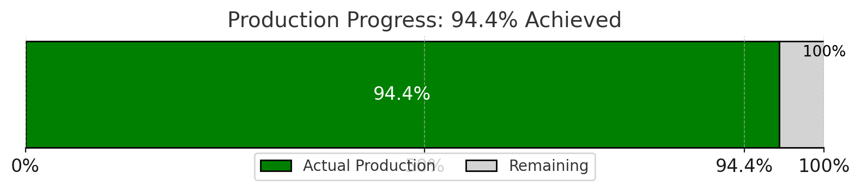

IMPACT
Efficiency Matters.
-$60M
Notes:
Right now, we’re achieving 94.4% of our target output. That gap may not sound large, but for us, it means we’re leaving potential on the table.
Downtime not only affects production but also strains resources, creates inefficiencies, and puts additional pressure on our teams, and is costing Swire $60M
But, obviously we all know this, the question is, how can we make sure we hit 100%?

Slide 4
What success looks like
Reliable: Machines running consistently without unexpected stoppages.
Efficient: Maximized output with minimal delays.
Scalable: A solution that grows with your production needs.

Slide 5
Solution
Collect Data
Gather real-time and historical data from machinery, sensors, and maintenance logs.
Plan Maintenance
Analyze Patterns
Schedule proactive repairs.
Understand the factors that contribute to frequent breakdowns.
Predict Failures
Leverage machine learning models and survival analysis to forecast potential downtimes
Notes:
By analyzing data from the machines, we can predict when a breakdown is likely to occur. This allows us to prevent failures through scheduled maintenance and ensures optimal performance. This isn’t just a plan; it’s a proactive step toward transforming our operations.

Slide 6
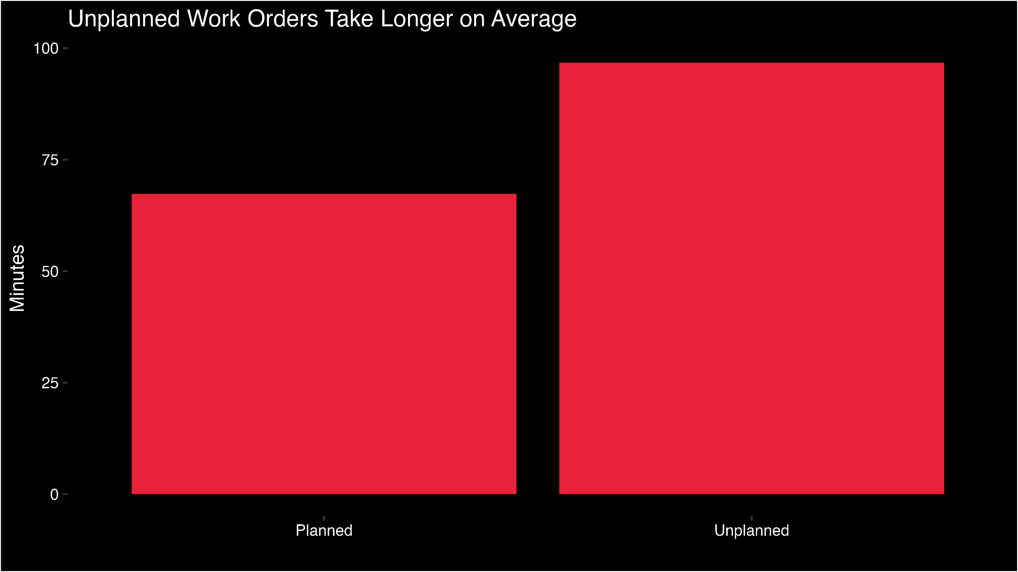
Planned vs Unplanned Failures
Notes:
Planned downtimes take less time on average than unplanned downtimes. Also, there are significantly more unplanned work orders than planned.

Slide 7
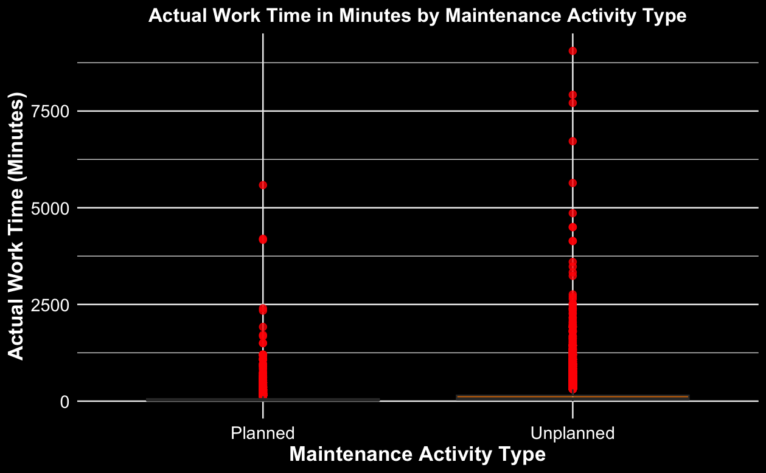
Failure Types Cont.
Notes:
This visualization shows that while most failures are dealt with quickly and do not require substantial time, there are a small number that cause significant delays in production. We can also see that unplanned failures have more occurrences that require more in depth solutions and take longer.

Slide 8
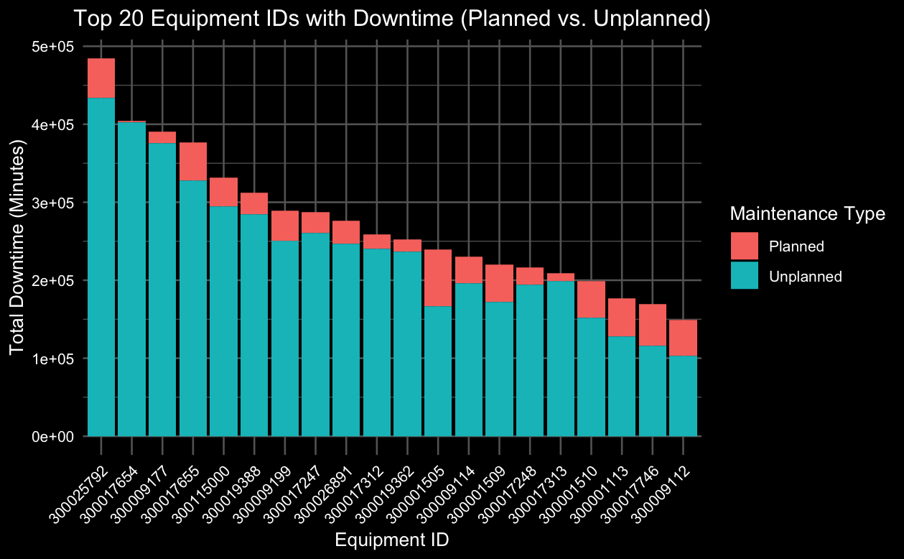
Equipment_IDs With Highest Downtime
Notes:
We were also curious which Equipment_IDs caused the most downtime. Unfortunately because the majority of the work orders do not have an Equipment ID we could not pinpoint exactly which was the most, but if the production facilities focus on proactively planning downtimes for these equipment IDs specifically, there would be a large effect. If we could shift even 10-20% of downtimes to planned we could reduce the total downtime. This would involve taking greater control over some of the unplanned orders, such as ordering replacement parts preventatively and keeping items stocked. In order to have a more proactive approach, we performed a survival analysis to have a better understanding for the timelines of equipment parts.

Slide 9
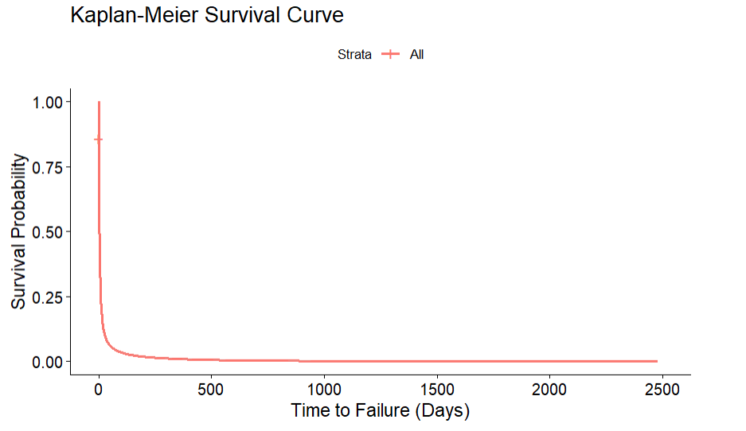
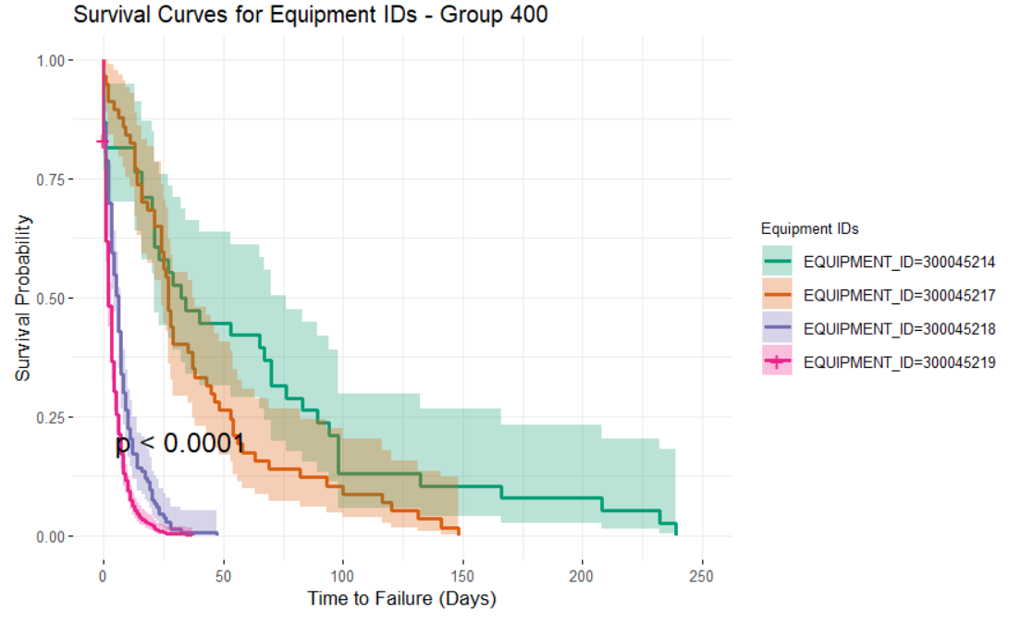
Our Solution: Survival Analysis
A statistical approach to model the time until an event occurs e.g. machine failure
Improves Maintenance Planning to reduce downtime and cost
Identifies high risk Equipment that contributes to failure
Kaplan-Meier Survival Curve to show survival probability across all 7 years
p-value: <0.0001

Slide 10
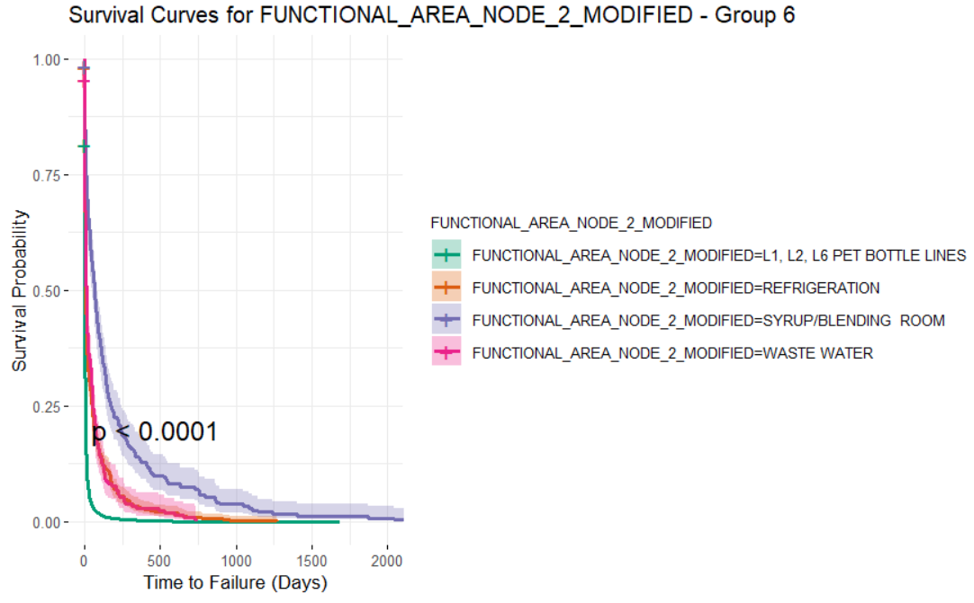
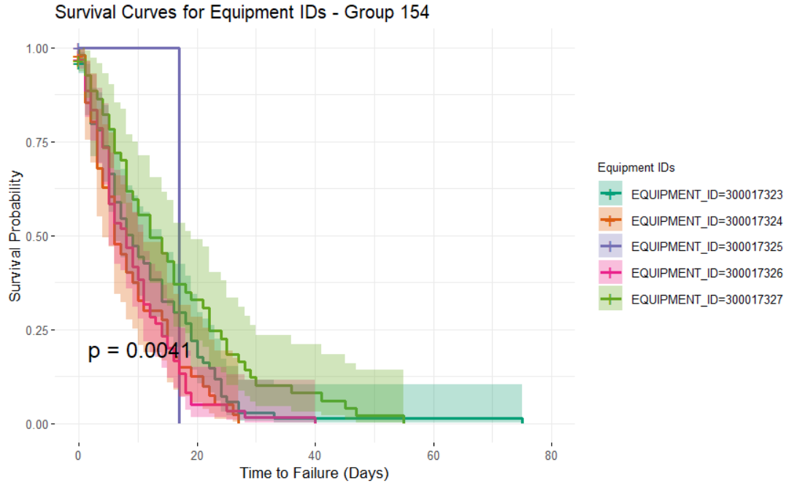
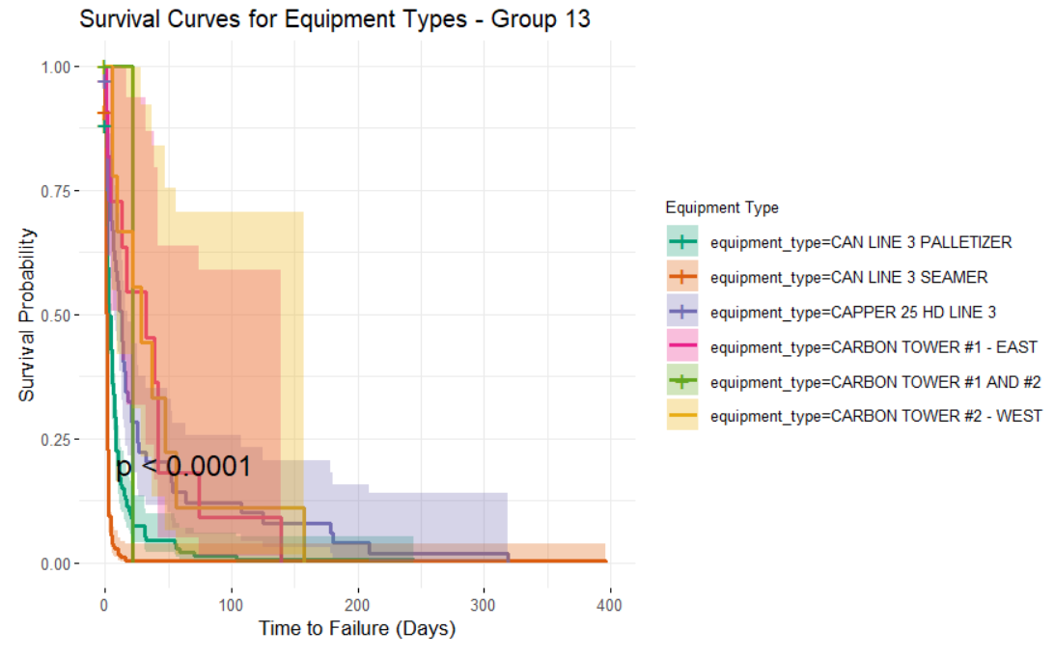
Survival Analysis Across Multiple Granularities
Survival Analysis at Varying Levels of Detail:
From Functional Area to Equipment Types to Equipment IDs
A total of 2956 Survival Curves were created for each Equipment ID, limited p-value due to the proportion of data available

Slide 11
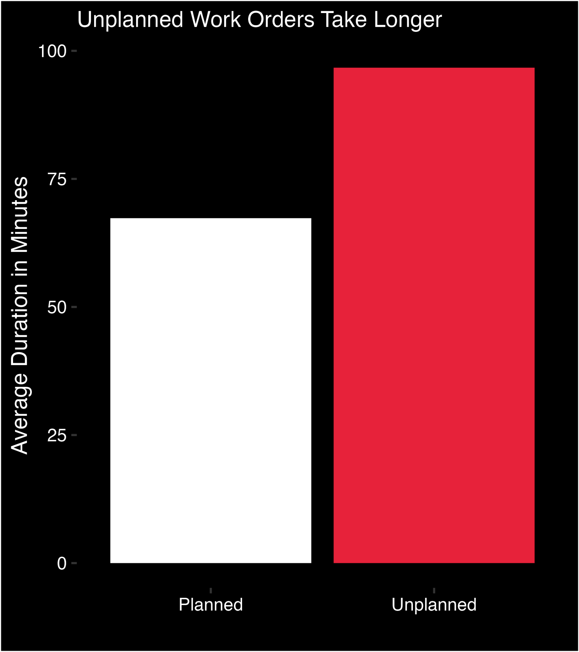
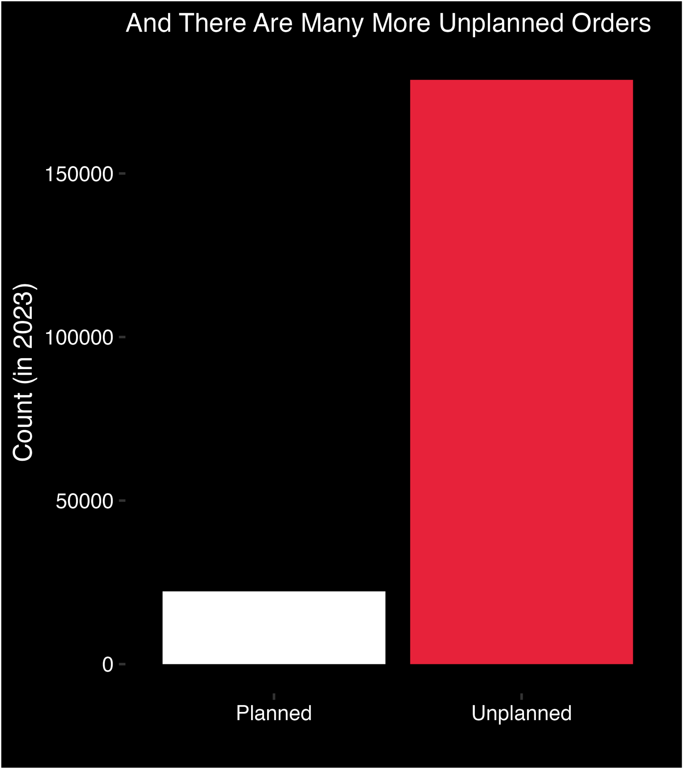

Slide 12
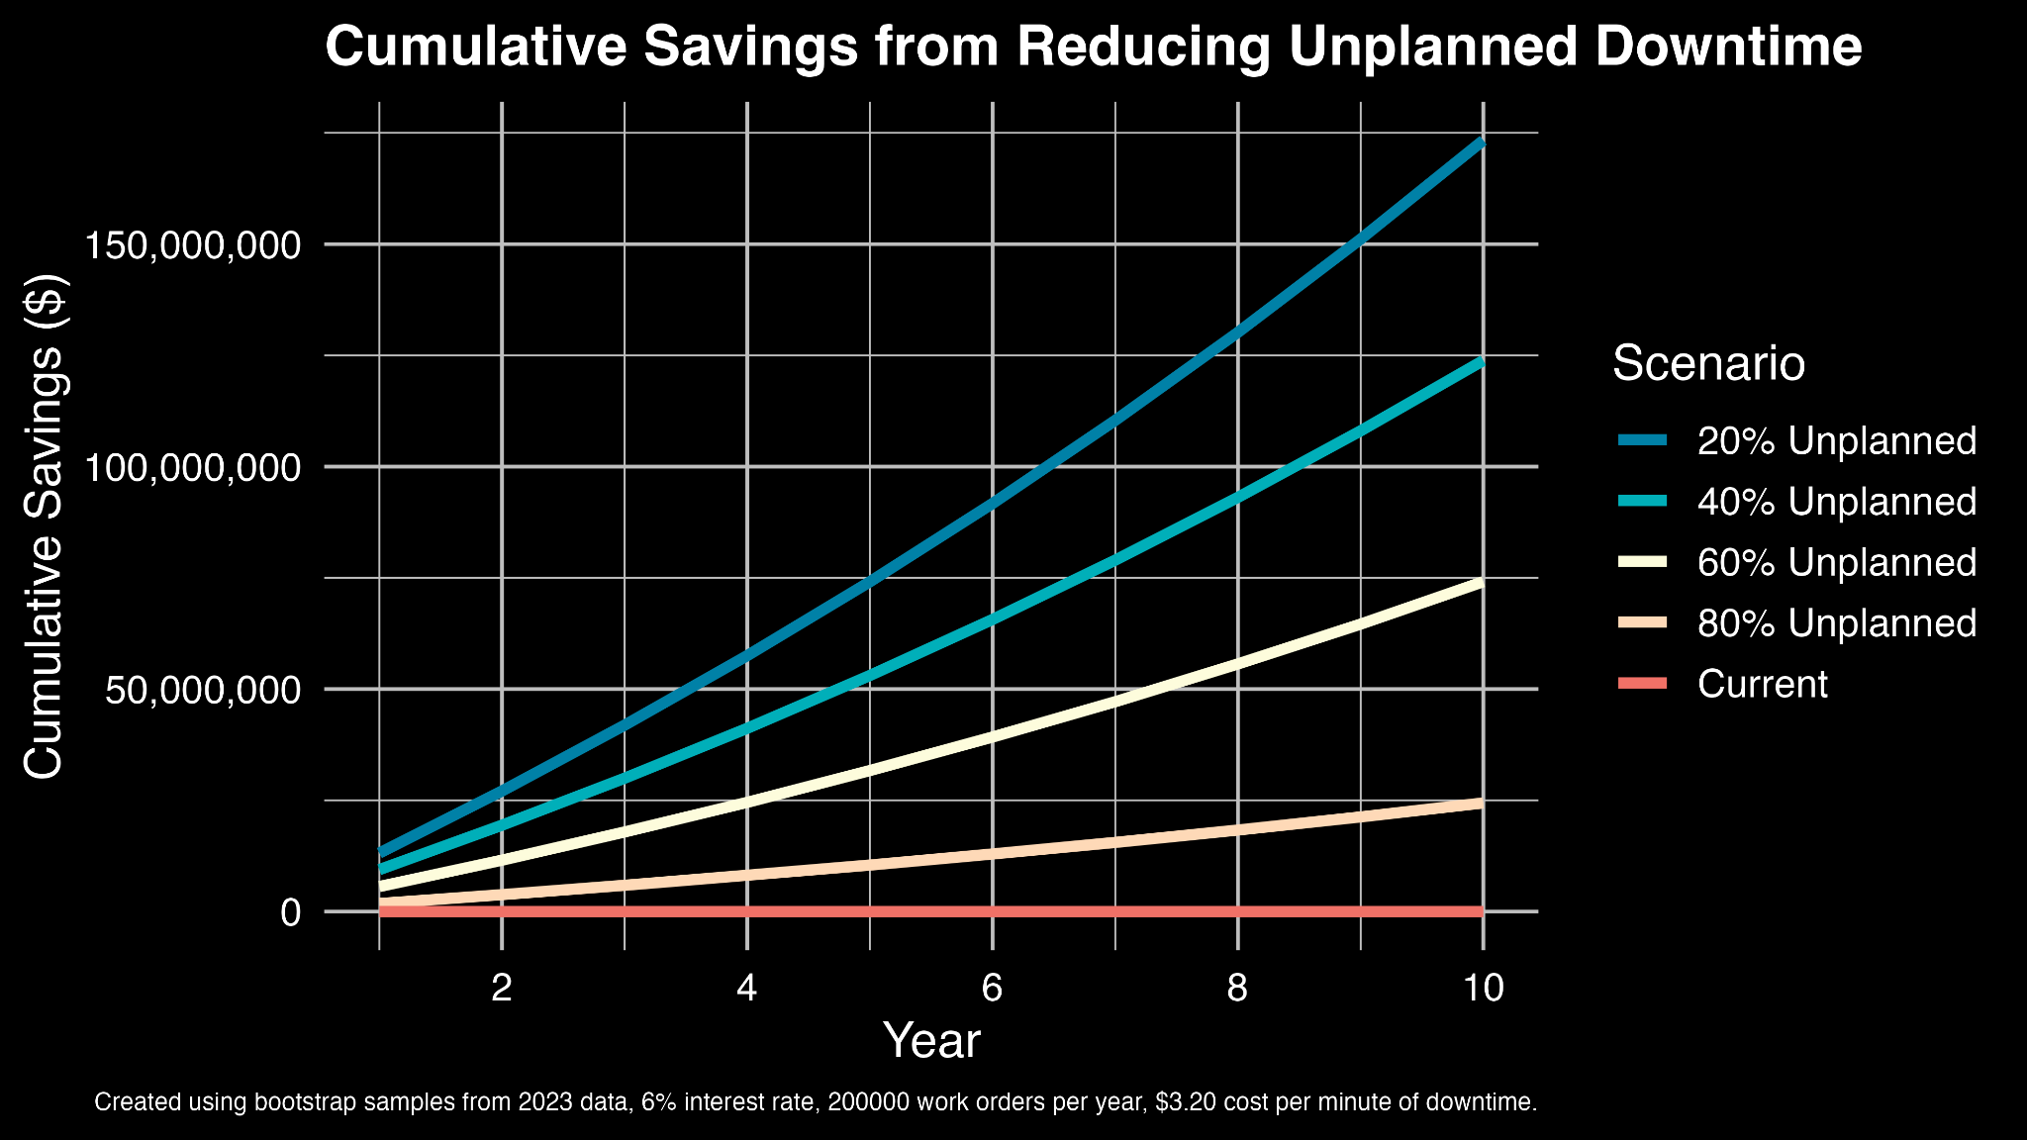

Slide 13
Thank You!

